Slide 1
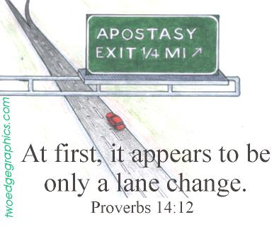
Notes:
As we begin to get into the meat of our study on church history, its important to understand how apostasy begins. It never begins with large steps, else it would be too easy to recognize. Satan deals in deceit and would have us to fall prey to sin when we least expect it. Therefore Satan likes to use men to introduce apostasy very slowly and subtly so that by the time we’ve completely turned away, we’ll be too far gone to easily return. The study of church history is a study of the small steps that Christians made that led to the gross and rampant apostasy that we see today. As we study these small steps, we’ll recognize that these steps led to other steps down a slippery slope to the creation of the first ever denomination that dominated the religious world for almost 1500 years.

Slide 2
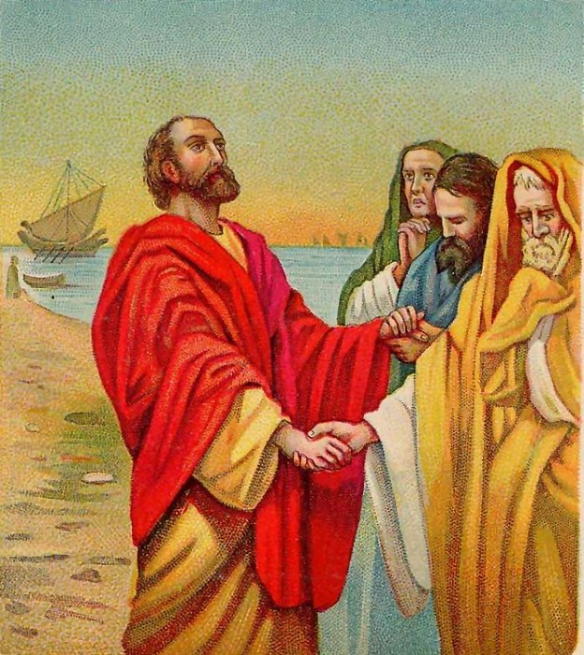
Predicted By Holy Spirit
Acts 20:28-31a – “²⁸Be on guard for yourselves and for all the flock, among which the Holy Spirit has made you overseers, to shepherd the church of God which He purchased with His own blood. ²⁹I know that after my departure savage wolves will come in among you, not sparing the flock; ³⁰and from among your own selves men will arise, speaking perverse things, to draw away the disciples after them. ³¹Therefore be on the alert…”
Notes:
The apostasy would occur was never something that should have taken first century Christians by surprise. As Paul addresses the Ephesian elders in Acts 20, he warns them of coming apostasy and encourages them to be on guard against it. When he describes this apostasy, he mentions that the ones responsible would come from “among them” rather than from outside the church. This would not be a matter of certain men just being untaught or meaning well in their intentions. Paul describes these men as savage wolves who would not spare the flock. They will draw many after them and speak perverse things. His admonition to them is to keep alert against such men. He is warning them not to be naïve about the great danger of false teachers!

Slide 3
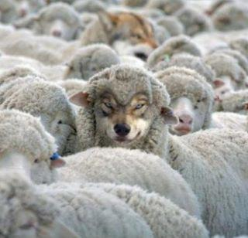
Predicted By Holy Spirit
1 Tim 4:1-3 – “¹But the Spirit explicitly says that in later times some will fall away from the faith, paying attention to deceitful spirits and doctrines of demons, ²by means of the hypocrisy of liars seared in their own conscience as with a branding iron, ³men who forbid marriage and advocate abstaining from foods which God has created to be gratefully shared in by those who believe and know the truth.”
Notes:
In 1 Tim 4, Paul warns Timothy about how in later times some Christians would fall away from the faith. He then tells them that the reason is because they will start taking seriously the doctrines of deceitful men, which he calls the doctrine of demons. These men will teach false doctrines – forbidding marriage, advocating abstaining from certain foods, etc. Paul’s point is that this is unavoidable. And unless we know and understand God’s word and can use it to defend the faith, we are susceptible to being pulled away by such men. Men such as these do not appear to us with horns on their hands. They seem like genuinely sincere and good people. They are hospitable and “loving”. But they are also very skilled at exploiting unstable brethren and taking advantage of their anger and bitterness to accomplish their selfish goals.

Slide 4
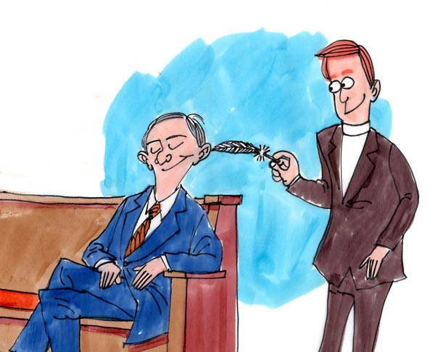
Predicted By Holy Spirit
2 Tim 4:2-4 – “²Preach the word; be ready in season and out of season; reprove, rebuke, exhort, with great patience and instruction. ³For the time will come when they will not endure sound doctrine; but wanting to have their ears tickled, they will accumulate for themselves teachers in accordance to their own desires, ⁴and will turn away their ears from the truth and will turn aside to myths.”
Notes:
Paul warns Timothy later in 2 Tim 4 that there will come times when Christians no longer want to hear sound, stable doctrine. They will look for preachers and teachers who tell the what they want to hear. They will look for preachers and teachers who water down the truth and even turn aside from the truth to myths. And so hi admonition is to preach the gospel in season and out of season. Never stop standing for what is right even when doing so is not popular. Only when we’re consistent in the teaching and preaching of sound doctrine will brethren stand a chance at seeing false teachers coming.

Slide 5
Apostasies of the NT
Judaizing Teachers (Acts 15; Gal; Col 2)
Corinthian Church
Sectarianism (1 Cor 1-2)
Corruption w/the Lord’s Supper (1 Cor 11)
Some denying resurrection (1 Cor 15)
False letters circulating (2 Thes 2:1-2)
Selfish ambition in leadership (3 John 9-10)
5 of 7 Asian Churches departing
Ephesus: left her first love (Rev 2:4)
Pergamum: doctrine of Balaam & Nicolaitans (Rev 2:14-15)
Thyatira: Tolerated a “Jezebel” (Rev 2:20)
Sardis: Spiritually Dead (Rev 3:1)
Laodicea: Spiritually Lukewarm (Rev 3:15-16)
Notes:
There were various movements already beginning in the apostolic age.
Judaizing teachers were some of the first false teachers Paul had to deal with. These were men who could not break away from their culture and traditions that said a person had to be circumcised in order to be right with God, and so they attempted to force this upon Gentile converts who had become Christians.
The Corinthian church had a variety of problems effecting it – sectarianism, corruption of the Lord’s Supper and its purpose, and some among them were even teaching falsely concerning the resurrection.
Paul dealt with false letters circulating that were supposedly written by him. To counter this, he started signing his letters (2 Thes 3:17) which is one reason we know that we have the letters from Paul that he originally wrote.
In 3 John, we are introduced to a man named Diotrephes who was selfishly ambitious and who had problems with authority. He caused great havoc amongst the brethren John wrote to.
In Rev 2 and 3, 5 of the 7 churches that Jesus wrote to had serious issues and needed to repent if they were going to continue to receive the blessings Christ promised them.

Slide 6
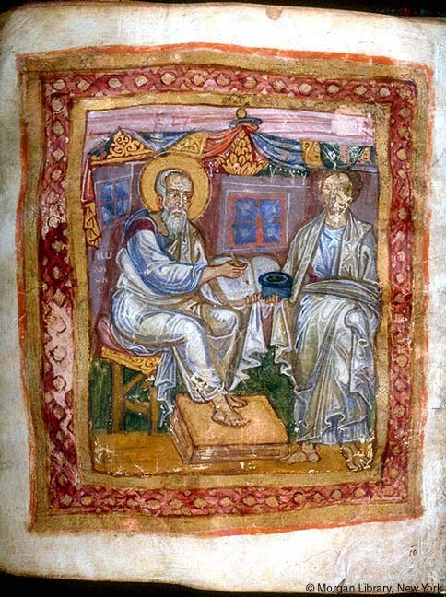
Post-Apostolic Apostasies
Gnosticism
Greek word “gnosis” = “knowledge”
Believed they had secret knowledge
Pandered to spiritual pride
Hellenistically influenced
Leaders: Marcion, Basilides, Valentinus
Dualism (OT God evil, NT God good)
The body and physical world are evil
Rejected Christ’s Humanity
Rejected Christ’s physical death
Rejected Christ’s resurrection
Notes:
The term “Gnostic” comes from the Greek word “gnosis”, which means “knowledge”. It refers to the diverse groups of people who did not ascribe to “orthodox” Christianity, believing they had secret "knowledge" of spiritual things that the common and ordinary man did not understand. The reason there were various Gnostic groups is because they all disagreed amongst themselves though they shared a few common traits. Just as Judaizing Christians were believers in Christ who were influenced by Jewish tradition, Gnostics were believers who were influenced by popular Hellenistic philosophies of that day. All Gnostics considered the God of the OT to be an inferior, ignorant God who made an evil creation and therefore believe all physical matter, including the body, was evil (though they disagreed whether they body’s desires should be met). The Gnostics who believed in Christ believed that He was one of the more superior and spiritual gods than the one from the OT, but they did not accept the idea that Christ came to earth in the flesh. They instead believed Him to be an apparition.
Because of their presuppositions about God and matter, they rejected some of the most essential and fundamental Christian doctrines. Since they denied His humanity, they denied His physical death, believing that Simon died on the cross instead of the apparitional Christ. Since they did not believe that Christ died, they did not believe in His resurrection from the dead. Several Gnostics wrote false gospels to in attempt to propagate their theories, though they were universally rejected from the canon. When this false teaching started infiltrating the churches, many Christians were struggling on how best to handle them.

Slide 7
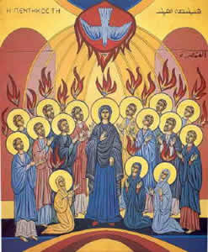
Post-Apostolic Apostasies
Montanism
Emerged ~155AD to claim divine inspiration from the Holy Spirit
Leading figures: Montanus, Prisca, & Maximilla
Believed 2nd coming of Christ was at hand
Practiced strict asceticism, forbade marriage, and required acts of penance
Believe its leaders forgave sins
Notes:
Montanism arose in the 2nd century where it was started in Phrygia by Montantus and ended up flourishing in the West as well as in North Africa. After his conversion to Christianity, Montanus came to Phrygia and claims to have fallen into a trance and started prophesying by the influence of the Holy Spirit. He claimed then to be the voice of the Spirit and the imminent second coming of Christ. He was joined by two women, Prisca and Maximilla, who left their husbands and also began prophesying. They were the 2nd century versions of the Charismatic movements of today.
Because they believed the 2nd coming of Christ was at hand, they laid down strict morality upon its followers – they forbade marriage, practiced asceticism, penance, and believed only its leaders could forgive sins. Tertullian was one of its most illustrious converts.

Slide 8
How Were They To Respond
2 Thes 2:15 – “So then, brethren, stand firm and hold to the traditions which you were taught, whether by word of mouth or by letter from us.”
1 Cor 11:2 – “Now I praise you because you remember me in everything and hold firmly to the traditions, just as I delivered them to you.”
Jude 3 – “Beloved, while I was making every effort to write you about our common salvation, I felt the necessity to write to you appealing that you contend earnestly for the faith which was once for all handed down to the saints.”
2 Thes 3:14 – “If anyone does not obey our instruction in this letter, take special note of that person and do not associate with him, so that he will be put to shame.”
Notes:
How should the Christians of the New Testament have responded to the apostasies that were taking shape? They were to remember to hold fast to the traditions the apostles gave them both by word of mouth as well as by letter. These traditions were the truths of New Testament Christianity has confirmed with power by the Holy Spirit Himself. Therefore, the words of the Apostles were to be the deciding matter in all doctrine associated with the church. They were to contend for this truth because it had been handed down once and for all. And if anyone did not obey the Apostles’ instructions, they were to be marked and unassociated with. In summary, the word of God was to be the deciding matter. The written word that we have in our possession today is to be standard by which he judge all religious practices and doctrine. This is what the Apostles taught and practiced. In fact, it is what our Lord Jesus both taught and practiced.

Slide 9
Action
Reaction
Local church organization was changed in an attempt to minimize the spread of heresy
Notes:
A study of church history is a study of over reactions to problems that occurred. One of the first examples of over reacting was concerning Christians’ decisions on how to deal with the rising threat of false teaching. In Matt 4, when Jesus was confronted by Satan, He answered every temptation by saying, “It is written” and then quoting scripture. Jesus believed that the word of God had the final say so in matters of doctrine and practice. But rather than following the word and keeping the NT’s pattern of autonomy to limit the spread of heresy, the began tweaking local church organization in an attempt to consolidate the faith and keep churches from falling away. What they didn’t realize at the time was that their proposed solution would lead to the very thing they were trying to prevent.

Slide 10
Local Church Organization
All terms refer to the same office
 | Elder/Presbyter (Presbuteros) | Overseer/Bishop (Episkopos) | Shepherd/Pastor (Poimen)
Acts 20:17, 28
Tit 1:5, 7
1 Pet 5:1, 2
Notes:
In the NT, local churches are to be overseen by certain men according to the qualifications listed in 1 Tim 3 and Tit 1. There are 3 different Greek words used to describe this office: “presbuteros” which is translated as elder or presbyter, “episkopos” which is translated overseer or bishop, and “poimen” which is translated shepherd or pastor. We know these terms refer to the same office because all three are used in Acts 20 when Paul is giving his farewell address to the elders in Ephesus. 2 of the 3 terms are used in the list of qualifications in Tit 1 and 2 of the 3 terms are used in Peter’s exhortation to elders in 1 Pet 5. This is essential to understand if we’re to properly understand the changes that were made in church history because in the 2nd century, distinctions began to be made in these terms.

Slide 11
Local Church Organization
Bible teaches each local church had a plurality
Acts 14:23 – “When they had appointed elders for them in every church, having prayed with fasting, they commended them to the Lord in whom they had believed.”
Acts 20:17 – “From Miletus he sent to Ephesus and called to him the elders of the church.”
Phil 1:1 – “Paul and Timothy, bond-servants of Christ Jesus, to all the saints in Christ Jesus who are in Philippi, including the overseers and deacons.”
Tit 1:5 – “For this reason I left you in Crete, that you would set in order what remains and appoint elders in every city as I directed you”
Notes:
In addition, the NT teaches that individual local church are to have a plurality of elders. In each and every case where elders are referred to in a church, there was always more than one. While we are never told why, this is the approved pattern the bible teaches and we must respect that pattern and abide by it. Practically speaking, though, it is harder for a local church to fall away to false teaching when more than one man is shepherding the flock. They also have each other to lean on in times of distress. Having more than one elder gives the church a proper sense of checks and balances that is lost in a church overseen by merely one man.

Slide 12
Local Church Organization
Bible teaches elders only have authority in their local church
Acts 20:28 – “Be on guard for yourselves and for all the flock, among which the Holy Spirit has made you overseers, to shepherd the church of God which He purchased with His own blood”
1 Pet 5:1-3 – “¹Therefore, I exhort the elders among you, as your fellow elder and witness of the sufferings of Christ, and a partaker also of the glory that is to be revealed, ²shepherd the flock of God among you, exercising oversight not under compulsion, but voluntarily, according to the will of God; and not for sordid gain, but with eagerness; ³nor yet as lording it over those allotted to your charge, but proving to be examples to the flock.”
Bible teaches elders in a local church are equal in authority
See every passage where elders are mentioned
Notes:
Also, the NT pattern is clear that the elders in a local church are limited in their authority to the local church they oversee. They are only to shepherd the flock of God among them. An elders cannot effective shepherd sheep in whom they are intimately acquainted with. Because they are limited in authority to their local church, this means that each local church is separate, independent, and autonomous from the other. No local church can dictate what another local church can do, though every church must be guided and upheld by the word of God.
Finally, because each local church must have a plurality of elders and because “elder”, “overseer”, and “pastor” are the same office, each elder is equal in authority. No elder should have the right to usurp the authority of another elder in the same position despite ambition, talents, or otherwise.

Slide 13
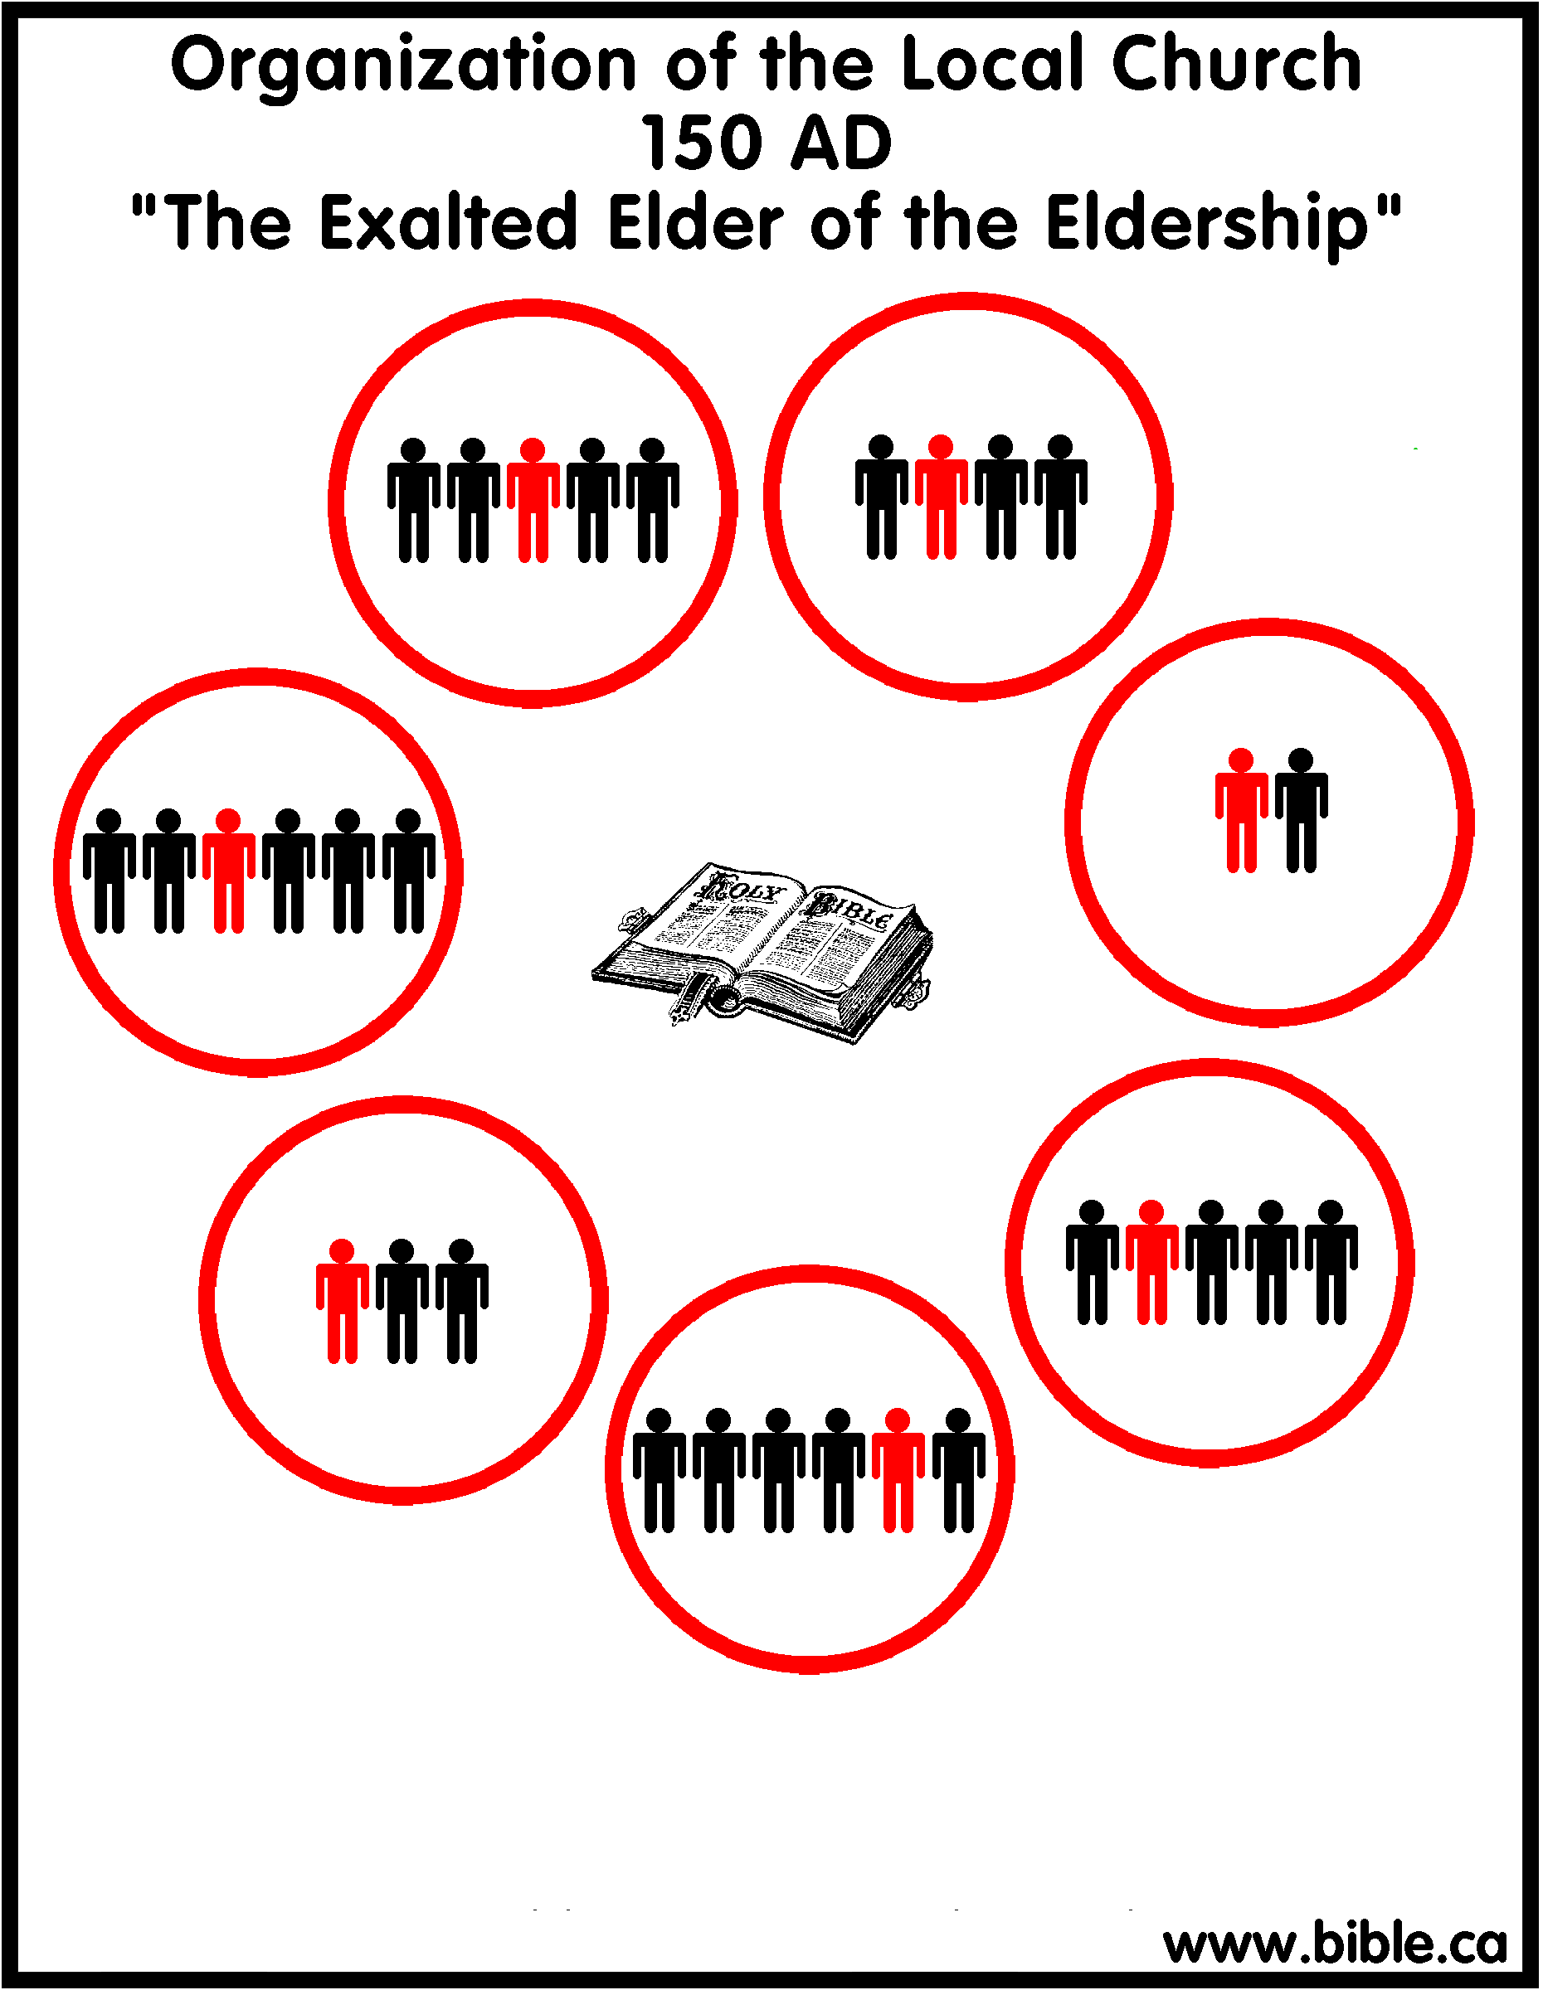
Local Church Organization Changes
2nd century, distinction in titles
Reasons:
Ambition
Response to false teaching
designation of “president” or “presiding bishop”
Eventually the term “bishop” began to be applied exclusively to this one elder
Notes:
In the 2nd century, churches began changing their organizational structures in response to the rapid spread of false teaching. The first that came about was that one man started to stand above the other elders in a local church. The reasons for this could be ambition, talent, etc. What we do know is that one elder in the local church became known as the “president” or the “presiding bishop”. As time went on, this man would be referred to exclusively as the bishop while the others were merely the elders. The idea is that decisions could be made easier by entrusted sole power to one elder. This apostasy begins within only a few decades of the apostolic age.

Slide 14
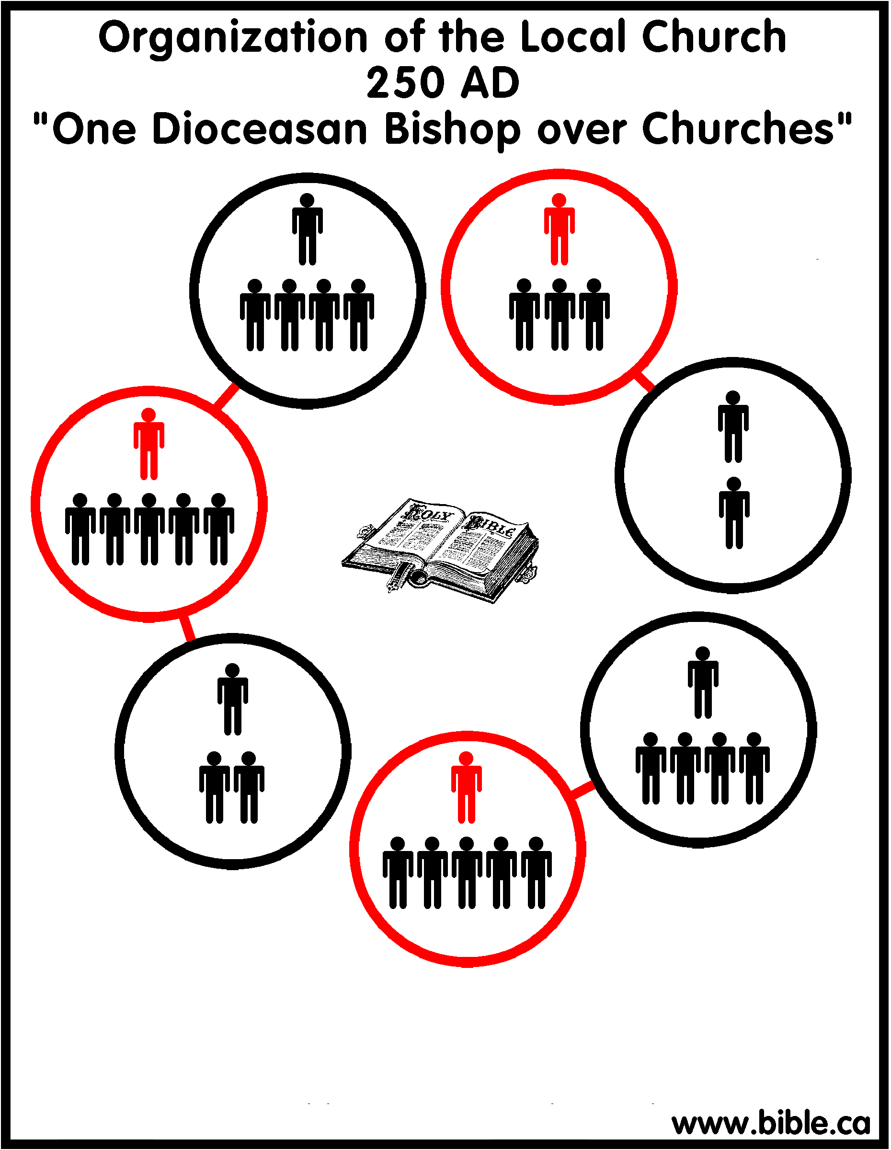
Local Church Organization Changes
3rd century, extension of authority outside of local congregation
City churches would establish churches in surrounding villages. Instead of being recognized as independent congregations, the bishop of the city church would control them
Bishops of big churches in larger cities came to be looked at with greater authority than other bishops:
“Diocesan Bishop”
Notes:
In the 3rd century, the elders’ authority began to extend beyond the local church they were members of. When city churches were established, the gospel began to be spread out from these city into the smaller surrounding cities. Instead of the new churches that started being recognized as independent, the bishop of the big city church would control them. The bishop of this big city church would then be known as the diocesan bishop. He would rule over the bishops of the other churches who in turn rules over the elders of the same church. A pyramid hierarchy began to be formed.

Slide 15
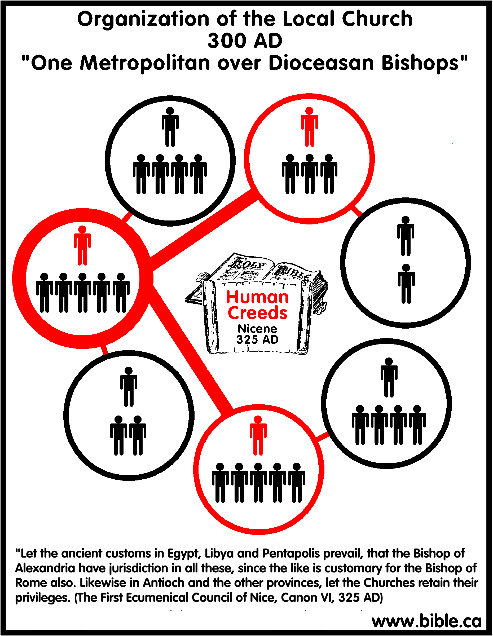
Local Church Organization Changes
4th century, metropolitan bishop developed
The diocesan bishop from the largest city became known as metropolitan bishops
Several diocesan bishops were under the authority of the metropolitan bishop
Notes:
By the 4th century, the diocesan bishop of the big city churches founded by the apostles were said to be succession to the apostles, and hence their teaching was held to be more authentic and their authority reciprocal. This diocesan bishop became known as the metropolitan bishop. Several diocesan bishops would be under the authority of the metropolitan bishop from this church and the pyramid was getting larger. Church autonomy was now becoming a thing of the past.

Slide 16
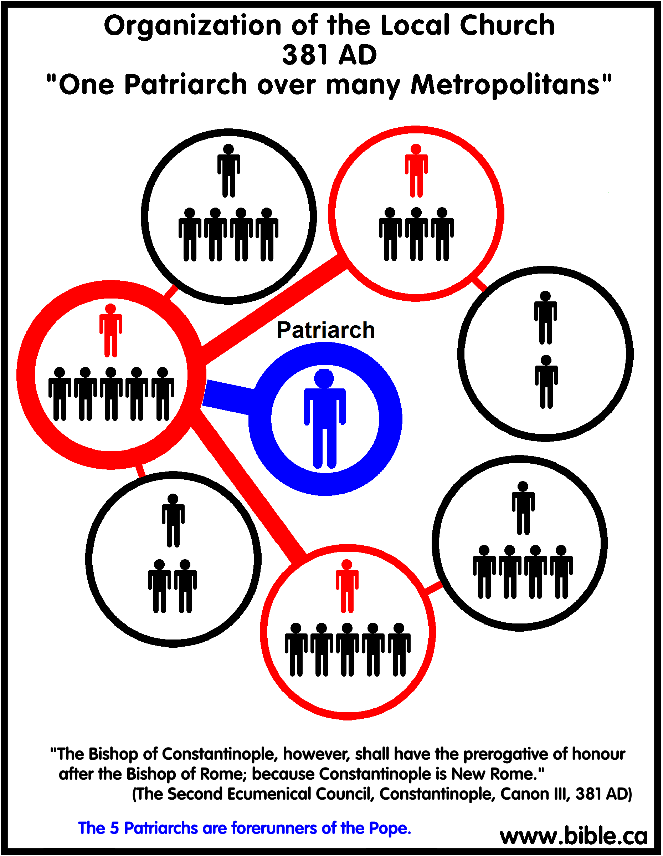
Local Church Organization Changes
Late 4th century, 5 patriarch bishops developed
The patriarch bishop became head over metropolitan bishops
Rome
Alexandria
Antioch
Constantinople
Jerusalem
Notes:
By the last 4th century, consolidation of power rose to a new level. It was deemed that the bishops of 5 great cities of the Roman Empire should have preeminence – Rome, Constantinople, Jerusalem, Antioch, and Alexandria. These 5 cities were seen as preeminent because of their significance in church history as their association with the apostles who established them. Though these patriarch bishops were to be equal in power, they were to oversee metropolitan bishops in their respective regions.

Slide 17
Local Church Organization Changes
Development of the Pope
In 588 the Patriarch of Constantinople, John the Faster, declared himself Universal Bishop
Gregory the Great, Patriarch of Rome, declared it apostasy
In 606, Boniface III, Patriarch of Rome, declared himself Universal Bishop
This ongoing battle for supremacy between the western and eastern portion of the church eventually led to the schism
Notes:
Not satisfied with the present man-made hierarchy, John the Faster, patriarch of Constantinople decided to declare himself Universal Bishop over the church. This self-promotion was not received well as the patriarch of Rome, Gregory the Great, declared it apostasy and urged John the Faster to renounce the title. However, when Gregory the Great died, the new patriarch of Rome, Boniface III, declared himself Universal Bishop. This feud between the patriarchs of Rome and Constantinople would continue for hundreds of years until Constantinople would eventually break away from Rome and begin the Eastern Orthodox church as a separate entity from the Roman Catholic church.
What began as a simple unscriptural distinction between elders and bishops followed by other small changes in local church organization caused one of the greatest departures from New Testament Christianity since its inception – the Roman Catholic church. By the time of the first declaration of Universal Bishop (Pope), the identity of the church was so skewed from the NT that it was barely recognizable. However, all throughout history there have been men and women who have attempted to bring people back to pure unadulterated Christianity.

Slide 18
Local Church Organization Changes
The rise of “apostolic succession”
Gnostics claimed a secret tradition coming down from the apostles as the authority for their teaching
Churches answered by claiming each bishop in a church founded by an apostle took over his same chair (“cathedra”)
At first it went from “holder of office” to “ordainer of office”; later it went from “ordainer” to “ordained”
This strengthened the pyramid organization developing within the church, particularly for “patriarchal bishops”
Notes:
When Gnostics wanted to gain traction in their teaching, they began making the claim that their secret “knowledge” came directly from the Apostles themselves. There had already been attempts made to forge letters written by Paul (2 Thes 2:2), and many other false gospels would were written. Though they were never accepted as canon because the churches knew which letters were authentic, churches overreacted to this issue as well by attempting to claim that each “bishop” in a church founded by an apostle took over his same chair (“cathedra”). While at first they were referred to as “holder of office”, over time it was changed to “ordainer of office” and later became “ordained”. This false idea of apostolic tradition further strengthened the new pyramid ecclesiastical hierarchy, particularly for patriarchal bishops.

Slide 19
Questions For Discussion Next Week
In what ways can our culture pollute Christianity?
How do we prevent those with selfish ambition from taking over the church?
How do Christians avoid running to one extreme to avoid another?
Notes:
Here are our questions for next week:
Why what ways can our culture pollute Christianity?
How do we prevent those with selfish ambition from taking over the church?
How do Christians avoid running to one extreme to avoid another?

Slide 22
Practical Questions
1) In what ways can our culture pollute Christianity?
Notes:
As discussed last week, many false doctrines of the 1st and 2nd century were the result of Christians not being able to separate their traditions and culture from Christianity. Judaizing teachers were not able to break away from certain aspects of Judaism. Gnostics were heavily influenced by Hellenistic culture. In what ways has American culture influenced Christianity?

Slide 23
Practical Applications
In what ways can our culture pollute Christianity?
Freedom/Rights
Phil 2:3-4 – “³Do nothing from selfishness or empty conceit, but with humility of mind regard one another as more important than yourselves; ⁴do not merely look out for your own personal interests, but also for the interests of others.”
Marriage
Matt 19:4-6 – “⁴And He answered and said, ‘Have you not read that He who created them from the beginning made them male and female, ⁵and said, “For this reason a man shall leave his father and mother and be joined to his wife, and the two shall become one flesh”? ⁶So they are no longer two, but one flesh. What therefore God has joined together, let no man separate.’”
Honoring the “king”
1 Pet 2:17 – “Honor all people, love the brotherhood, fear God, honor the king.”
Rom 13:1 – “Every person is to be in subjection to the governing authorities. For there is no authority except from God, and those which exist are established by God.”
Notes:
First, American culture is a “rights oriented” society. Much of this is derived from the fact that we have constitutional rights that protect certain of our freedoms, allowing greater latitude in our decision making as opposed to other countries. We have freedom of speech, a right to bear arms, freedom to worship as we wish, the right to a prompt, fair trial, the right to vote in the elections of public officials, the right to run for elected office, and the right to pursue “life, liberty, and the pursuit of happiness.” These rights are so engrained within us that when challenged we will say, “It’s a free country!” However, as citizens of God’s kingdom, we are taught to forgo our rights for the sake of others (Phil 2:3-4). We may have to sacrifice certain of our liberties if means not causing our brethren to stumble (Rom 14:13). It may even be that we have to sacrifice the liberties we have that are incumbent of being a US citizen if it means maintaining our citizenship in heaven. We must be on guard against allowing supposed liberties to detract from our responsibilities as Christians to love God with everything we’ve got and to love our neighbor as ourselves.
Second, the marriage laws of the US are profoundly different from what the bible teaches. In the US, you can divorce your spouse for any reason and remarry (Matt 19:9). But the bible only allows divorce and remarriage when your spouse commits adultery against you. Recent laws now allow same sex marriages, but God’s law says in that in the beginning, God made them male and female and that it was for this reason they would be joined together (Matt 19:4-6). Many marry and divorce without a proper understanding of God’s law and find themselves in difficult situations where tremendous sacrifices must be made to fully repent because we allow our culture in the US to drive our decision making.
Third, the bible explicitly commands us to honor the king and to place ourselves under submission to governing authorities. Yet the US right of freedom of speech means that we cannot be arrested for saying anything negative about our governing authorities. Sometimes Christians can go overboard in their criticism of our president to the extent where they are not honoring him at all. We must remember that the king during the time of Paul and Peter’s writing was Nero. He was a far worse leader than any that we have had in the US up to this point.

Slide 24
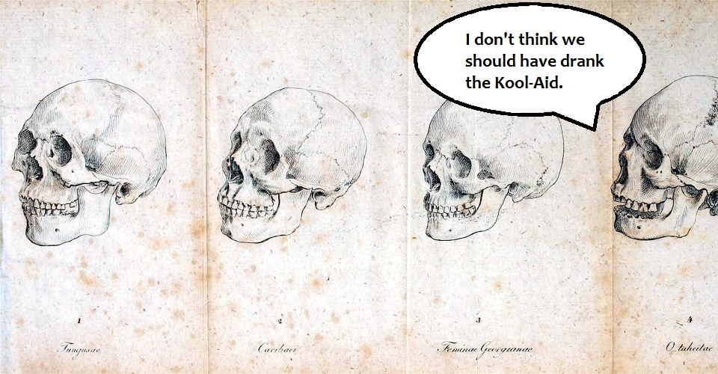
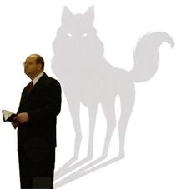
Practical Applications
How do we prevent those with selfish ambition from taking over the church?
Notes:
One of the primary causes for the changes in local church organization was the result of men with selfish ambition seeking authority and power never authorized by the New Testament. Diotrephes of 3 John is a prime example of what happens when Christians within local churches allow certain members to have too much power. Given the devastation that this caused in the early church, how do we prevent it?

Slide 25
Practical Applications
How do we prevent those with selfish ambition from taking over the church?
Be Strong & Courageous
Heb 12:12 – “Therefore, strengthen the hands that are weak and the knees that are feeble.”
Urge Servitude
Matt 23:11 – “But the greatest among you shall be your servant.”
Bring To Light
Eph 5:11 – “Do not participate in the unfruitful deeds of darkness, but instead even expose them.”
Turn From Them
Rom 16:17 – “Now I urge you, brethren, keep your eye on those who cause dissensions and hindrances contrary to the teaching which you learned, and turn away from them.”
Notes:
First, we should not fear anyone who is stepping outside the bounds of authority. One of the worst things that can happen in local churches when a brother is sinning is for brethren to sit on their hands and not take a stand against them. Christ deserves better. We need to summon up the courage of our biblical predecessors and do what is right even when it is not convenient and may cost us. God is looking for brave, courageous followers to lead.
Second, we must encourage those who are power hungry to be humble servants. Every time the apostles began arguing and vying for power, Christ was quick to remind them through teaching and example that the greatest among them are servants. Watch those who believe to be selfishly ambitious. Do they humbly serve? Or are they leeches for public praise and adoration? While some will be wolves in sheep clothing, their fruit will eventually betray them – wisdom is vindicated by her children.
Third, we need to expose those who practice such deeds. Sin does its worst damage when it remains in the darkness. The only way to aptly and appropriately deal with it is if we bring it into the light so that men can have opportunity to repent. And if they will not repent, we need to bring it to the light so other brethren can know what is going on and have opportunity to respond.
Fourth, if those not living according to Christ’s teaching continue in their rebellion, we must turn from them and even remove them from our fellowship. False teachers cannot remain in a position to influence others or it will produce a leavening affect with irreparable damage.

Slide 26
Practical Applications
How do Christians avoid running to one extreme to avoid another?
Notes:
One of the consistent patterns we see in a study of church history is actions followed by over reactions. Mankind is notorious for attempting to avoid one extreme by running to by running to the other. What are the factors involved that cause this and how can we prevent it?

Slide 27
Practical Applications
How do Christians avoid running to one extreme to avoid another?
Rightly Divide
2 Tim 2:15 – “Be diligent to present yourself approved to God as a workman who does not need to be ashamed, accurately handling the word of truth.”
Don’t Give Into Fear
1 John 4:18 – “There is no fear in love; but perfect love casts out fear, because fear involves punishment, and the one who fears is not perfected in love.”
Notes:
First, we need to develop the proper spiritual discernment to know how to rightly divide the word of truth. This involves understanding context, comparing verses to other verses, and making reasonable and necessary conclusion.
Second, its important not to let our emotions get the best of us. We must not be afraid to find the balance God’s word teaches in all areas.

